Slide 1
Portal Tools
Focus Area: Foundation
Notes:
KEY
Introduce the module to participants
HOW
Briefly, introduce the module objectives
TIME
1 min

Slide 2
Training Overview
Group Workshop
Back-end
Front-end
Services
Integration
Content
Services
Advanced
Security
Widget Development
Widget
Extras
Targeting
Publishing
Container
Development
Foundation
Portal Essentials
Portal Technologies
Portal Tools
Portal APIs
Notes:
KEY
Introduce the module to participants
HOW
Briefly, introduce the module objectives
TIME
1 min

Slide 3
Objectives
Become familiar with the CXP Manager
Managing catalogs,
Managing pages, layouts, and widgets
Managing portal rights
Become familiar with the CXP Explorer
Become familiar with command line interfaces
Notes:
KEY
Objectives
HOW
Explain each goal
TIME
1 min

Slide 4
CXP Manager
Portal Tools

Slide 5

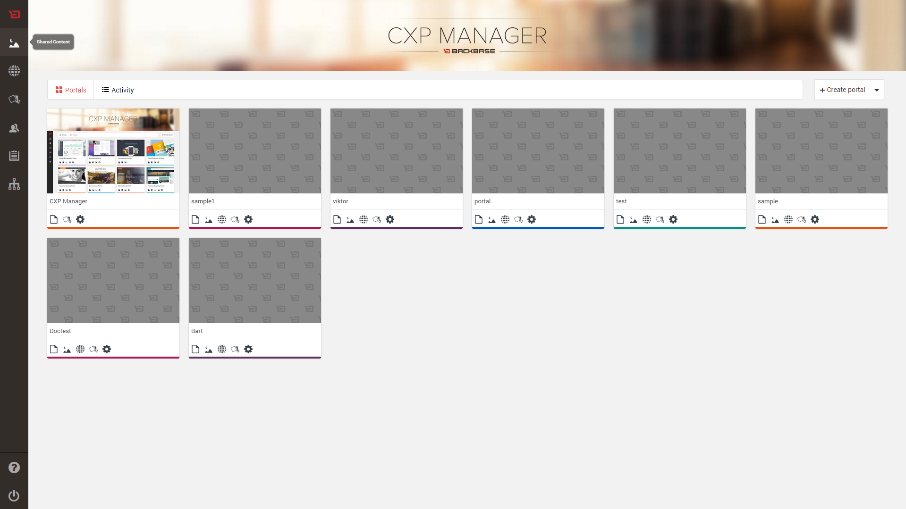
CXP Manager Demo
Notes:
KEY
Show the CXP manager
HOW
Remind participants that CXP manager is a tool used to change the portal model.
Elements to show:
Global level
Enterprise catalog
Content Services
Portal level
Settings, permissions
Catalog
Content Services
Page management
TIME
3 min

Slide 6
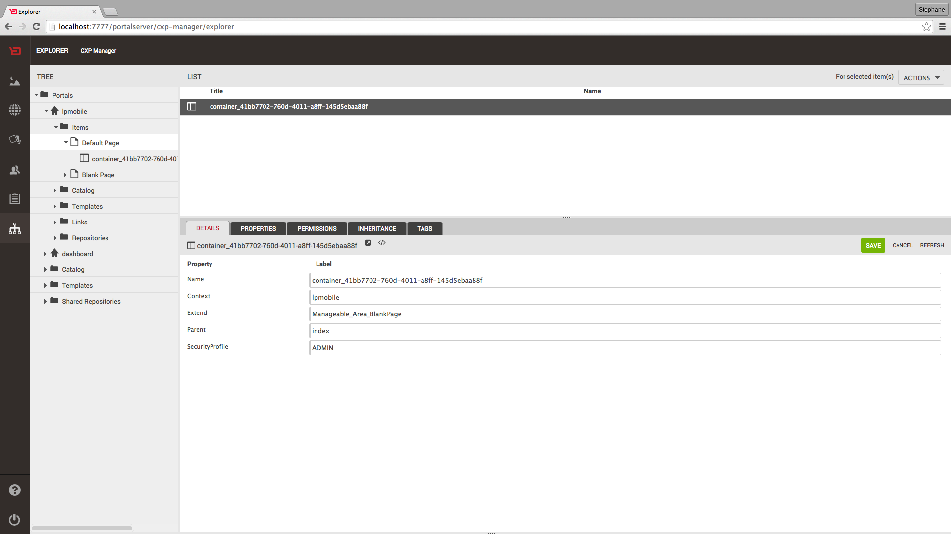
CXP Explorer Demo
Notes:
KEY
CXP explorer
HOW
Present the CXP explorer tool
TIME
3 min

Slide 7
bb-cli
An introduction to the command-line interface

Slide 8
bb-cli
CXP has a command line tool, allowing you to automate and simplify your daily workflow by providing convenience methods, such as:
Scaffolding widgets and containers
Packaging and deploying collections
Notes:
KEY
BB-CLI information
HOW
Give a brief overview of bb-cli
TIME
3 min

Slide 9
Exercise: Create a Widget with bb-cli
Creating your first widget using Launchpad
Installation: https://github.com/Backbase/bb-cli
Using the command bb generate, you can scaffold a variety of items, like widgets and containers.
Format:
bb generate <template>
Example:
bb generate widget-lp:
Will generate a new subfolder containing all widget
resources (html, JS, and model descriptor).
Notes:
KEY
Creating a hello-world widget
HOW
Attention: This is the tutorial for Launchpad-based projects. Only follow this guide if this is the case.
Proposed demo script
Open the terminal window
Enter into your project directory
Point to the statics folder and create a folder called mycollection
Enter into the mycollection folder
Run bb generate widget
name: hello-world
Description: Hello World Widget
Tell participants that we have just created a widget skeleton
Go to the generated folder and list its contents
Show the model.xml descriptor
Explain that the widget is not in the portal yet

Slide 10
Exercise: Create a Widget with bb-cli
Creating your first widget using Widget Collection 2.x
Using the command bb-generate, you can scaffold a variety of items, like widgets and containers.
Format:
bb-generate <template>
Example:
bb-generate widget ng
Will generate a new subfolder containing all widget
resources (html, JS, and model descriptor).
Notes:
KEY
Creating a hello-world widget
HOW
Attention:This is the tutorial for Widget Collections 2.x-based projects. Only follow this guide if this is the case.
Proposed demo script:
Open the terminal window
Enter into your project directory
Point to the statics folder and create a folder called collection-training
Enter into the collection-training/src folder
Run bb-generate widget ng
? Name widget-training-hello-world-ng
? Title Hello World
? Description Hello world
? Version 0.1.0-alpha.0
? Do you want to create an extension now? Yes
? Do you want to create a model now, to connect the widget with APIs? No
Tell participants that we have just created a widget skeleton
Go to the extension generated folder (ext-training-hello-world-ng) and list its contents
Show the model.xml descriptor
Explain that the widget is not in the portal yet
Edit the HTML: templates/template.ng.html

Slide 11

Packaging and Importing Items
Portal Tools

Slide 12
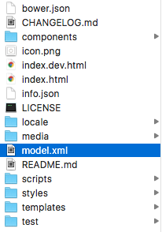
Packaging a catalog item
A catalog item is packaged in a zip file
All items have a descriptor (model.xml)
The descriptor specifies the Object Model of the item
Notes:
KEY
Catalog item structure
HOW
Explain the catalog item structure. Use a widget, template or container to explain the structure.
Open the model.xml file and show some relevant information.
Note that other files may be mandatory depending on the item you are importing, such as the widget definition for a widget or the Google Closure template file for a container template.
For more information, refer to the documentation at https://my.backbase.com/docs/product-documentation/documentation/portal/5.6.0/catalogitems_exportoutput.html#/list
TIME
3 min

Slide 13

Import Items
Using CXP Manager:
Create a zip file containing your resources
The model.xml descriptor must be at the root of your archive
Click on the button in the top left corner of the Enterprise Catalog interface
Drag & drop your zip file onto the file area
Using the command line tool
Notes:
KEY
How to import items
HOW
Explain two common importing mechanisms: CXP Manager and bb-cli
TIME
3 min

Slide 14
Exercise: Importing Widgets
Importing your widget using Launchpad
Format:
bb import-item [options]
Examples:
bb import-item
Will import the item into the enterprise catalog
bb-import-item –W
Auto-import option, watching for file changes
Notes:
KEY
Importing components
HOW
Attention: This is the tutorial for Launchpad-based projects. Only follow this guide if this is the case.
We propose the demo in two steps:
Importing the widget:
Import the Hello World widget using two mechanisms:
Zipping the widget and importing it using CXP manager
Calling bb import-item inside the widget folder
Show the imported widget in the enterprise catalog
Using the widget
Add this widget to the portal demo catalog
Create a page that uses the widget
Show the hot deployment option (bb import-item –W)
Change the widget (e.g. open the index.html and change the Hello World message)
Check if the widget was imported automatically
Sometimes the editor does not change the timestamp. If this is the case, force the timestamp change using touch <filename>
Refresh the page that uses the widget:
Sometimes you should force the page to reload using the browser (e.g. Using Chrome, go to the inspect mode, right-click on the reload button and select the option empty cache and hard reload)
TIME
6 min

Slide 15
Exercise: Importing Widgets
Importing your widget using Widget Collection 2.x
Format:
bb-package [folder]
bb-import [package zip file]
Examples:
bb-package .
Will package all of the items in the current folder
bb-import package.zip
Will import the package.zip file into CXP
Notes:
KEY
Importing components
HOW
Attention: This is the tutorial for Widget Collections 2.x-based projects. Only follow this guide if this is the case.
We propose the demo in two steps:
Importing the widget:
Go to the statics/collection-training/src folder and run:
bb-package .
bb-import package.zip
If you change the widget/extension, do not forget to package again before importing it
Using the widget
Add this widget to the portal demo catalog
Create a page that uses the widget
TIME
6 min

Slide 16
Exporting and Importing Portals
Portal Tools
Notes:
KEY
Exporting and importing portals
HOW
Do not spend too much time on this topic; refer participants to the documentation.
TIME
1 min

Slide 17
Exporting/Importing of Portals
Portals can be exported from one CXP environment and imported into another
What is exported?
The entire portal structure (e.g. pages, containers, widgets, external links, headers, aliases, etc...)
Content items
What is not exported?
JSP/SOY templates, widget chrome templates, widget definitions, JavaScript, and CSS files
Notes:
KEY
Exporting/Importing Portals
HOW
To find out more, refer to the documentation: https://my.backbase.com/docs/product-documentation/documentation/portal/5.6.2/importexport_portals.html#/list
TIME
2 min

Slide 18
Exporting/Importing of Portals
Interfaces
{ REST }
$>
CXP Manager
REST API
Command Line
Notes:
KEY
Interfaces
HOW
Ask participants why we need to export or import portals?
Explain that CXP provides three mechanisms for importing/exporting portals.
Their outcomes are always compatible: You can export using CXP Manager and import using the command-line tool
CXP manager: Remind participants that not all CXP instances have CXP manager installed.
REST API: A convenient interface for exporting/importing portals
Command-line interface: When the REST API is not available
TIME
1 min

Slide 19


Exporting process
Export Portal Model
Portal Model
XML format
Portal Items: e.g. pages, containers, and widgets
Portal Catalog
Rights: List of rights granted for each item
Export Portal Archive
Portal Archive
Zip file
Portal content
Shared content used by pages (optional)
All portal server groups (optional)
Notes:
KEY
How to export
HOW
Explain the exporting process.
TIME
2 min

Slide 20
Exporting Portals using CXP Manager
CXP Manager
Export Portal Model
Portal Model
XML format
Export Portal Archive
Portal Archive
Zip file
Notes:
KEY
How to export
HOW
Explain the CXP manager interface.
To find out more: https://my.backbase.com/docs/product-documentation/documentation/portal/5.6.2/portals_exportviacxp.html#/list
TIME
2 min

Slide 21
Exporting Portals using the REST API
REST API
Export Portal Model
Portal Model
XML format
Authenticated GET request
GET http://acme/portalserver/export/portal?
portalName=acme-bank&includeGroups=false
Export Portal Archive
Portal Archive
Zip file
Two-phase process
Authenticated POST request to prepare the archive
POST http://acme/portalserver/orchestrator/export/exportrequests
<exportRequest>
<portalExportRequest>
<portalName>acme-bank</portalName>
<includeContent>true</includeContent>
<includeGroups>false</includeGroups>
</portalExportRequest>
</exportRequest>
It returns the archiveId to be downloaded in the next step
Authenticated GET request to download the archive
GET http://acme/portalserver/orchestrator/export/files/{archiveId}
Notes:
KEY
How to export
HOW
Explain the command-line interface.
To find out more: https://my.backbase.com/docs/product-documentation/documentation/portal/5.6.2/portals_exportviarest.html#/list
TIME
2 min

Slide 22
Exporting Portals using the command line tool
Command-line
Export Portal Model
Portal Model
XML format
$> java -jar importer-5.6.x.x-jar-with-dependencies.jar
export-portal-model -i acme-bank -f acme-bank.xml
-s http://acme/portalserver
-u admin -p adminpwd
Export Portal Archive
Portal Archive
Zip file
$> java -jar importer-5.6.x.x-jar-with-dependencies.jar
export-portal -i acme-bank -f acme-bank.zip
-s http://acme:8083/orchestrator
-u sys2sys -p sys2syspwd -C
Notes:
KEY
How to export
HOW
Explain the command-line interface.
To find out more: https://my.backbase.com/docs/product-documentation/documentation/portal/5.6.2/portals_exportviacli.html#/list
The Importer can be downloaded from the repository:
e.g. https://repo.backbase.com/backbase-development-rc-releases/com/backbase/portal/tools/importer/5.6.x.x/importer-5.6.x.x-jar-with-dependencies.jar
TIME
2 min

Slide 23
Importing Portals using CXP Manager
Import Portal Model
Portal Model
XML format
CXP Manager
Import Portal Archive
Portal Archive
Zip file
Notes:
KEY
How to import portals using CXP
HOW
To find out more: https://my.backbase.com/docs/product-documentation/documentation/portal/5.6.2/portals_importviacxp.html#/list
TIME
2 min

Slide 24
Importing Portals using the command line tool
REST API
Import Portal Model
Portal Model
XML format
Authenticated POST request
POST http://acme/portalserver/import/portal
Content-Type: application/xml
<xml body here>
Import Portal Archive
Portal Archive
Zip file
Authenticated POST request
http://acme/portalserver/orchestrator/import/upload
Content-Type: multipart/form-data
<multipart-body here>
Notes:
KEY
How to import portals using the REST API
HOW
Explain that the importing process is separated in two parts.
To find out more: https://my.backbase.com/docs/product-documentation/documentation/portal/5.6.2/portals_importviarest.html#/list

Slide 25
Importing Portals using the command line tool
Command-line
Import Portal Model
Portal Model
XML format
$> java -jar importer-5.6.x.x-jar-with-dependencies.jar
import-portal-model -f acme-bank.xml
-s http://acme/portalserver
-u admin -p admin
Import Portal Archive
Portal Archive
Zip file
java -jar importer-5.6.x.x-jar-with-dependencies.jar
import-archive -a acme-bank.zip
-s http://acme:8083/orchestrator
-u sys2sys -p sys2sys
Notes:
KEY
How to import portals using the command line interface
HOW
Explain that the importing process is separated in two parts.
To find out more: https://my.backbase.com/docs/product-documentation/documentation/portal/5.6.2/portals_importviacli.html#/list

Slide 26
Points To Remember
CXP Manager is ideal for Business Users
CXP Explorer, easier for technical users to work with the Portal
CXP provides a command-line interface for automation
CXP has different interfaces for importing or exporting portals

